Slide 1
Josep Maria Solé i Chavero
Lawyer & CEO
09-09-2021

Slide 2
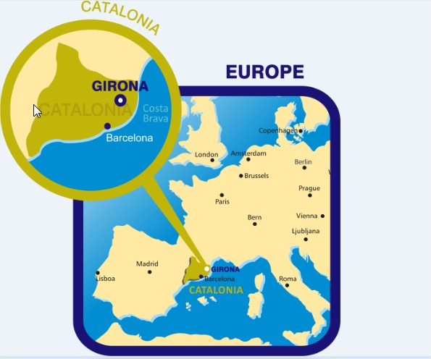
Where we are
Where are we located?
Support-Girona, before known as Girona Guardianship Foundation was born on 11th April 2003, promoted by IAS, the Public Health Service Provider and Manager of the Network of Mental Health and Addictions in Girona. At that time about 500 people lived permanently in the Psychiatric Institution and many of them were warded by the institution (sometimes by the director of the institution). The creation of the Foundation was an integral part of the strategy of Deinstitutionalisation.
Support-Girona is shifting towards practices based on the recognition of Rights of the individual based on the UNCRPD. SUPPORT promotes the exercise of Rights by empowering individuals to achieve social inclusion, increasing their autonomy and respecting the will and preferences of the person. We support individuals in their decision-making process, enabling them to live in the community and respecting their Right to Legal Capacity among other Rights.

Slide 3
A quick look at our organisation (I)
DEFENSE & PROMOTION OF HUMAN RIGHTS
DEVELOP EQUIPMENTS & SERVICES BASED IN THE COMMUNITY
AWARENESS RAISING
LEGAL ACTIONS, IF NEEDED
LEGAL SUPPORT
SOCIAL & COMMUNITY-BASED SUPPORT

Slide 4
Origins
NGO-NPO
Born on 11th April 2003
Promoted by the Public Health Service Provider in Girona as part of the Deinstitutionalisation strategy taken place without specific funding.
Conceptualised as an intense social service.
Developed as a service included in the Catalan Portfolio of Social Services and using the Catalan Civil Code as main legal framework.
Provides SUPPORT to every person that could need support to make and manage decisions as a non-exclusive factor (Intellectual disabilities, psychosocial disabilities, elderly people experiencing dementia,…)

Slide 5
A quick look at our organisation (II)

Slide 6
The new Spanish Legal Framework
(Law 8/2021)
“Law on the reform of Civil and Procedural legislation to support persons with disabilities in the exercise of their legal capacity”.
The law establishes a preference on voluntary measures but…. “in exceptional situations, where despite significant efforts have been made, the will, wishes and preference of the person could not be determined,…, representative functions could be included”
Powers of attorney and preventive mandates (256 to 262 “mandate without a power of attorney”)
De facto guardian (263 to 267): Central mechanism with temporary authorisation (Voluntary Jurisdiction).
Curatorship (268 to 270) “Only in exceptional situations, the curator will be able to assume the representation of the PWD”
Self-curatorship (271 to 281) and commons (282 to 294)
Judicial ombudsman (295 to 298)

Slide 7
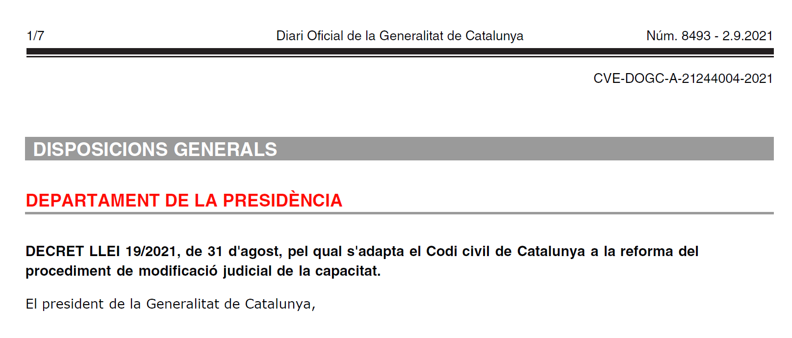
The Catalan Decree
(Law Decree 19/2021 from 31th August)
“Adapting the Catalan Civil Code to the reform of the procedure to modify legal capacity”
In effect since September 3rd 2021
Temporary measure with legal effects until a new Catalan Civil Code is drafted and approved.
Relies on the “Assistance” as a mechanism to provide support to persons who need it.
The “Assistance” can be constituted judicially and by notary.
Forbids the use of “Guardianship”, “Curatorship” and extended or rehabilitated “Parental Authority”.

Slide 8
Assistance – Catalan Civil Code (Art. 226 §)
Exclusive of the Catalan Civil Code. It does not exist in other communities in Spain.
Adults with a ‘non-disabling impairment’ of physical or mental faculties may voluntarily request the judicial authority to appoint an assistant, by the procedure of voluntary jurisdiction.
The judicial authority must respect the will of the person when appointing an assistant.
The resolution must specify the areas or spheres in which the assistant can act (health, financial management, personal) always respecting the will and preferences of the person.
The acts that the person carries out without the assistant are valid, but voidable/nullified if they are considered harmful.
Judicial control of the role of the assistant (safeguard).

Slide 9
Ordinary / Structural Financing
The service is included as a specialised social service in the Catalan Portfolio of Social Services (Decree 142/2010), deployed as a result of the approval of Law 12/2007 on Social Services.
The Catalan Civil Code establishes by law that the support service can only be offered by either the family network or from non-profit entities accredited as such (associations, foundations).
Main source of finance through the Department of Social Rights of the Catalan Government through a grant mechanism.
For each person that the entity supports, the organization perceives a fixed sum depending on the module assigned to the person by the administration.
The service is subject to a double supervision, the judicial authority to which the entity is accountable on an annual basis for every individual and to the administrative authority that sets the criteria and quality standards of the service.

Slide 10
Ordinary / Structural Financing

Slide 11
Why External Financing?
Usually, ordinary financing only covers basic aspects of service delivery. There’s a system gap between service delivery and the implementation of Human Rights. The following elements are essential to ensure organisations and NGOs:
Align with EU priorities (e.g. EU Disability Strategy 2021-2027, EU Youth Strategy 2019-2027, etc.)
Develop a strategy to advance in the implementation of Human Rights
Foster social innovation. Creation of new models, methodologies, processes (supported decision-making, community-based services)
Improve Quality Standards
Enhance capacity building and training of professionals within the organisation
Build alliances with other NGOs and with Public Authorities

Slide 12
Some Sources

Slide 13
Examples of External Financing

Slide 14
Lessons
Applying for external funding can be overwhelming at the beginning (bureaucracy, multiple programmes, lack of partners, specific jargon, conceptual frameworks)
Collaborative processes enrich the organisation and its professionals
Different partners & approaches oblige the organisation to think outside the box of ordinary service delivery but with a deep reflection of your own service.
Time & resources are essential to participate in EU funded projects. It’s not about receiving free money.

Slide 15
A glimpse on Support-Girona future projects
I-DECIDE+: Improving Supported Decision-Making tools for social inclusion
E-YOUTH: Empowering Youth individuals with fewer opportunities towards citizenship
GREENSOCIAL: Empowering the green transformation of social services
FACToRS: From A Convention To Renewed Services (Develop ‘Benchmark’ indicators & recommendations based on the UNCRPD)
COM-IN: Promoting communicative development in children and youth persons with intellectual & developmental disabilities to support their inclusion

Slide 16
www.supportgirona.cat
jmsole@supportgirona.cat
@supportgirona

